Slide 1
Computing Fundamentals

Slide 2
Course Information
Course title:
Course code:
Credit hours:
Instructor
Computing Fundamental(CF)
CF-110
2 (Theory) + 1 (Lab)
Engr. Mahawish
Email: mahwishfatima.bukc@bahria.edu.pk Department of Software Engineering Faculty Room # 05, 2nd Floor, Iqbal Block

Slide 3
Course Instructor
Engr. Mahawish
Assistant Professor, Software Engineering Department.
Formerly
Lecturer at DHA Suffa University.
Lecturer at Mehran UET.

Slide 4
Course Information(Cont.)
Textbook:
Computing Fundamentals: Introduction to Computers, by Faithe Wempen, 2015, John Wiley & Sons Publication.
Introduction to Computers, 7th edition, by Peter Norton, 2012, Tata McGraw Hill Education Pvt. Ltd.
Supplemental Materials:
Introduction to Computer Science, 6th edition, by G. Michael Schneider and Judith Gersting, 2013, Cengage Learning.
Computer Fundamental, by Anita Goel, 2015, Pearson Education.
Computer Networks. Andrew S. Tanenbaum and David J. Wetherall 5th edition, pearson

Slide 5
Course Information(Cont.)
Learning Objectives:
This course covers an introduction to computers, including its fundamental functions and operations. It provides elementary knowledge about the present day technologies. Information technology concepts are covered, along with basic awareness of how computers work and communicate. Emphasis is placed on developing rudimentary computer skills for students

Slide 6
Course Learning Outcomes
CLO | Statement | Bloom’s Taxonomy | Associated PLO
1 | Define the basic concepts and terminologies of a computer system and various Components of computer system. | C1 | PLO1
2 | Explain and differentiate between the various component of computer. | C2 | PLO1
3 | solve variety of problems related to computer systems including binary operations, number system conversions, network topologies, and databases. | C3 | PLO2
4 | Present given Computing Fundamentals course topics clearly and professionally in the front of class. | A6 | PLO10

Slide 7
Outcome Based Education(OBE)
Program Learning Outcomes
PLO 1: Engineering Knowledge.
PLO 2: Problem Analysis.
PLO 3: Design/Development of Solutions
PLO 4: Investigation.
PLO 5: Modern Tool Usage
PLO 6: The Engineer and Society.
PLO 7: Environment and Sustainability.
PLO 8: Ethics.
PLO 9: Individual and Team Work.
PLO 10: Communication.
PLO 11: Project Management.
PLO 12: Lifelong Learning.
Program Educational Objectives
PEO-1: Graduates should demonstrate competence in applying Software Engineering knowledge & practices in various phases of software/system development life cycle in their respective professional career.
PEO-2: Graduates should demonstrate an ability to work as a member and/or leader in a team with a strong sense of societal context, professional ethics and effective communication skills in professional practice.
PEO-3: Graduates should demonstrate sustained learning by pursuing life-long learning through graduate studies, professional development or managerial/leadership skills.

Slide 8
Grading System
Grade | Grade Point | LL % | UL %
A | 4.0 | ≥ 85 | -
A- | 3.67 | ≥ 80 | < 85
B+ | 3.33 | ≥ 75 | < 80
B | 3.00 | ≥ 71 | < 75
B- | 2.67 | ≥ 68 | < 71
C+ | 2.33 | ≥ 64 | < 68
C | 2.00 | ≥ 60 | < 64
C- | 1.67 | ≥ 57 | < 60
D+ | 1.33 | ≥ 54 | < 57
D | 1.00 | ≥ 50 | < 53
F | 0.00 | - | < 50
W | Withdrawn | - | -

Slide 9
Grading Criteria
Theory
Evaluation Instruments | Marks
Quizzes | 10
Assignments | 20
Mid-Term Exam | 20
Final Exam | 50
Total | 100
Lab
Evaluation Instruments | Marks
Lab Manual | 10
Lab Performances | 20
Lab Quizzes | 20
Lab Project & Viva | 50
Total | 100

Slide 10
Course Policies
Attendance
Students should attend all classes and labs.
Attendance will be taken regularly.
Absence greater than the allowed threshold will result in students being barred from taking the Final Exam.
A total of 45/48 Hrs of theory lectures will be delivered in the semester.

Slide 11
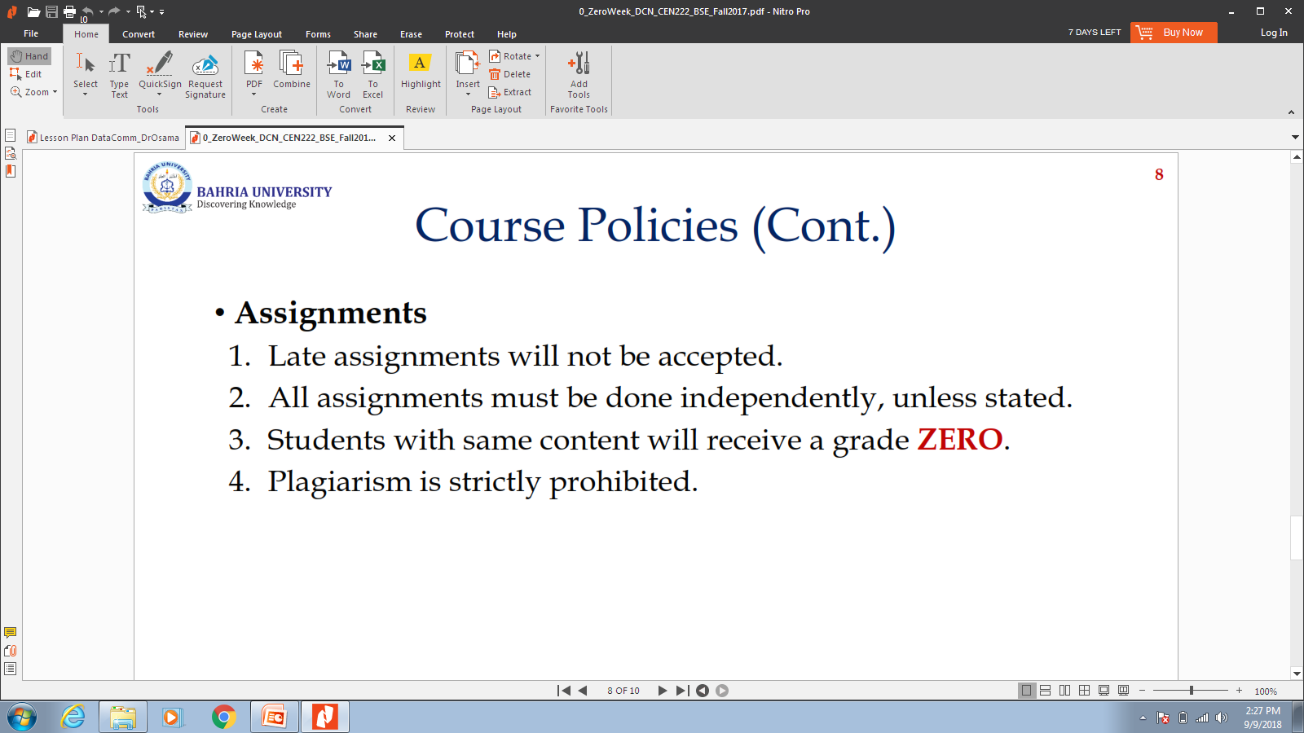
Course Policies

Slide 12
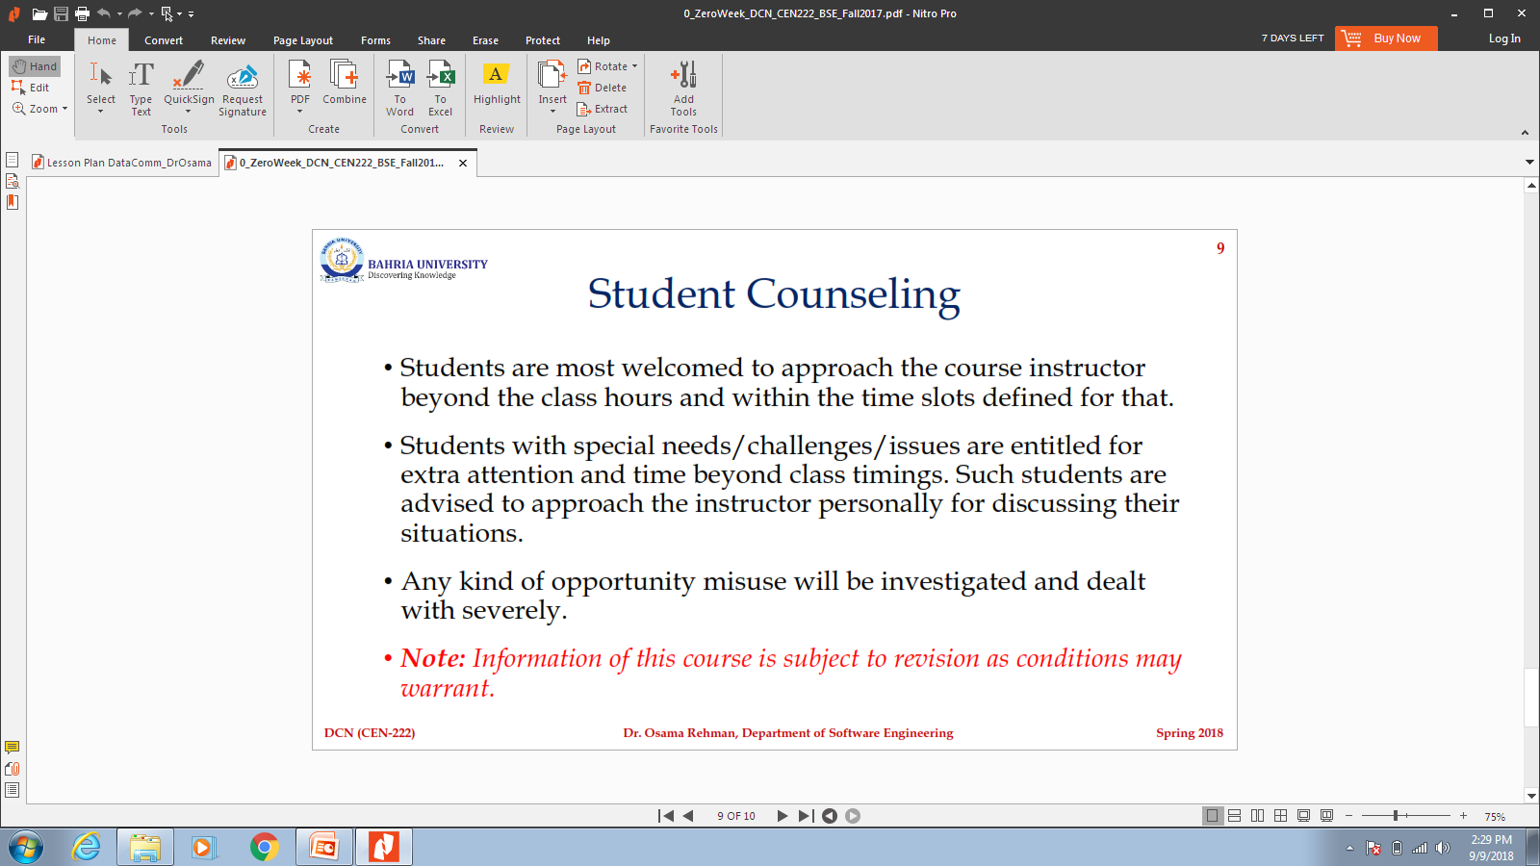
Student Counseling

Slide 13
Thank you

